Slide 1
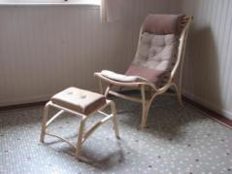
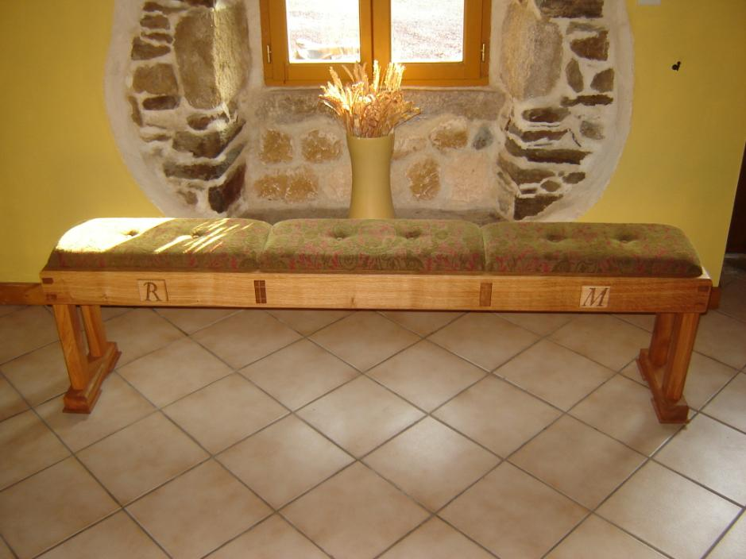
Kerry J Donovan Furniture Design
Bench/Settle© - a Winter Warmer
August 2012
Notes:
Trend Consulting 2006

Slide 2
It all starts with a client’s design brief.
Next comes a design drawing, the client makes any changes necessary, and then commissions the project
In this design the cushion seat opens to reveal a storage space for newspapers/kindling. The seat could be loose fitting seat or hinged. The bottom of the interior space would be 9mm MDF.
All external edges could be chamfered to catch the light and add interest.
Overall dimensions (mm):
Length (nominal) 1950
Height (nominal) 500
Width of seat: 320
Depth of seat: 115

Slide 3
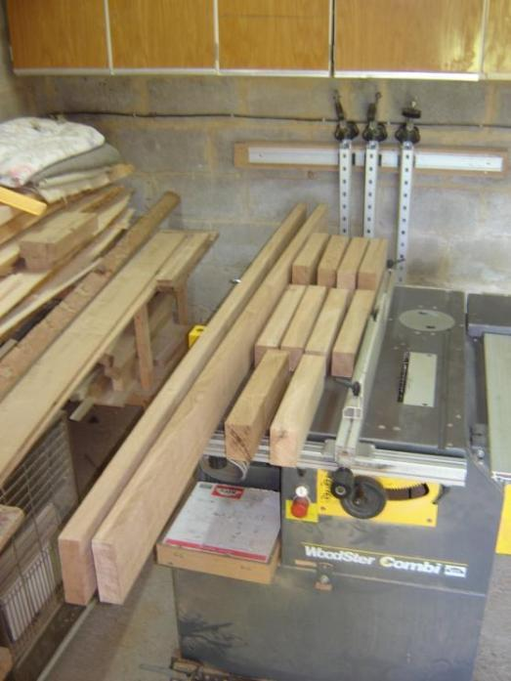
Once the project has been commissioned I select the wood
The material for this project (French Oak) is cut to nominal size and then planed-all-round (PAR) to the width and thickness needed....

Slide 4
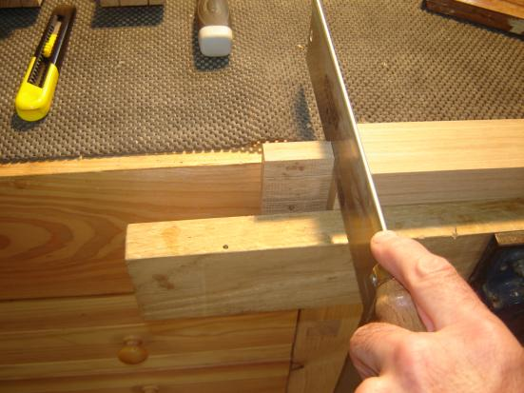
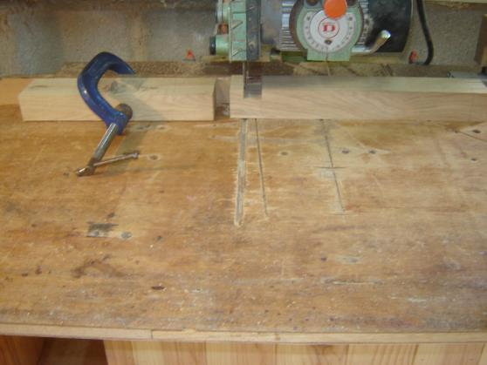
After marking them out carefully, I cut the joints
The joints are cut, mainly by hand (yes, I’m a leftie)....
..... and sometimes using a machine, (depending upon the joint needed). In this photo I am cutting one of the tenons using my radial arm reciprocal saw.

Slide 5
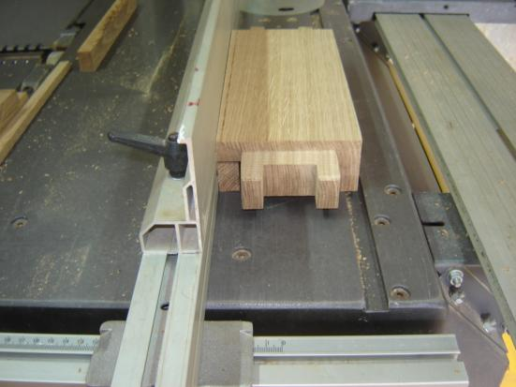
A number of different joints were used during this project. These mortise & tenon joints were used to join the seat rails to the sides.
This joint is a double tenon with saddle housing. It is a particularly strong joint, ideal for this project. The tenons are designed to protrude through the side rail of the bench as an interesting design feature.

Slide 6
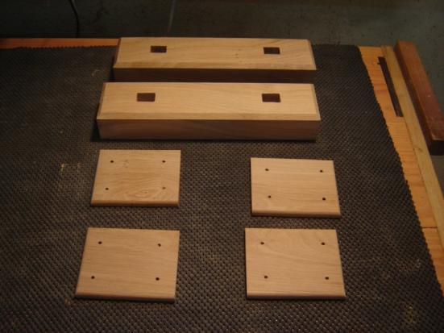
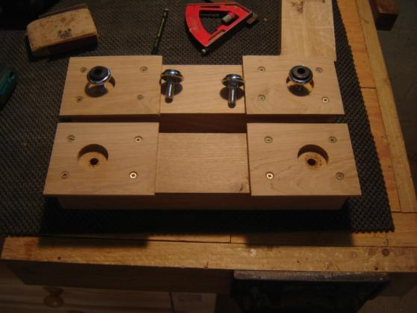
Design features included thin ‘shoes’ and hidden feet. The metal feet are adjustable to allow for uneven floors.
The ‘ski’ feet were fitted with thin ‘shoes’ as a design feature, they don’t take any load because....
.... hidden rubber-tipped metal fittings, screwed directly into the skis take all the weight of the bench.
Incidentally, the fittings are adjustable, in case your floors are uneven.

Slide 7
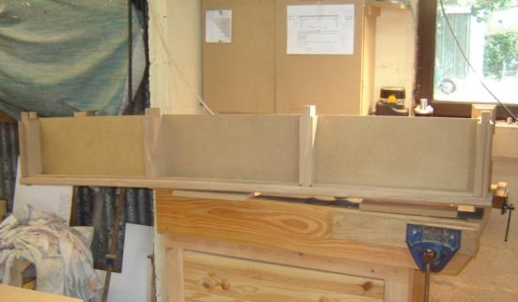
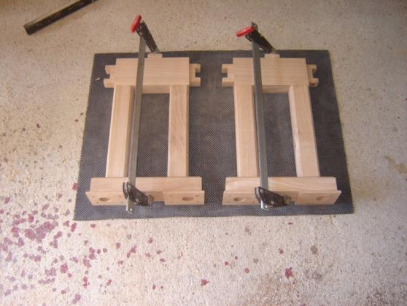
A number of dry test assemblies and copious clean-up processes are carried out before the glue-up stage.
Once cut, the joints are dry assembled to test for fit.
Then all the components are cleaned with abrasives and wire wool to make ready for gluing up process.
The legs, side rail, skis and feet are glued up in one operation. Then any glue spillages are cleaned.

Slide 8
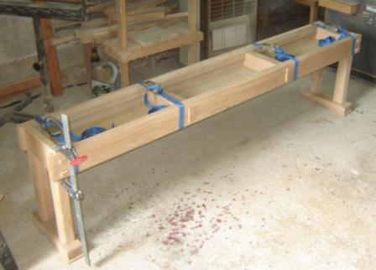
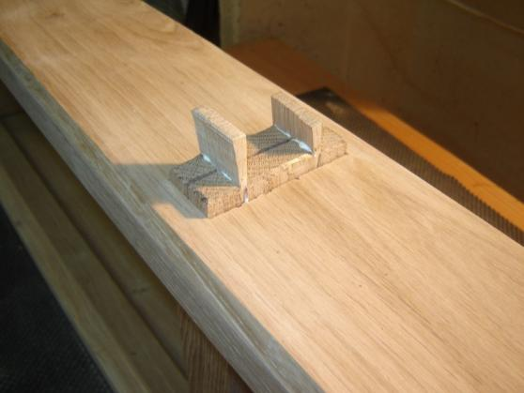
The bench is glued, clamped and the joints are ‘wedged’ and cleaned up
The bench is glued together and the joints are held under compression overnight for the glue to set hard.
I added wedges to the through tenons for strength and looks.....

Slide 9
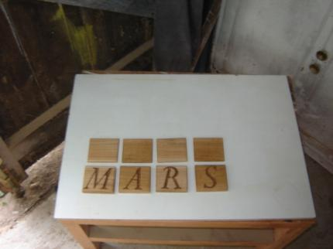
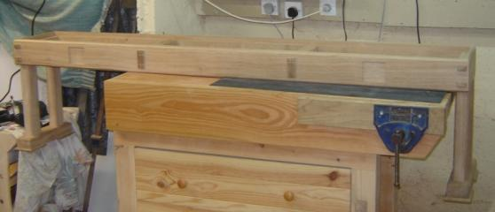
Carvings and other ‘design features’ are added
I carved initials of the family who commissioned the piece.....
Recesses will house the letters.....

Slide 10
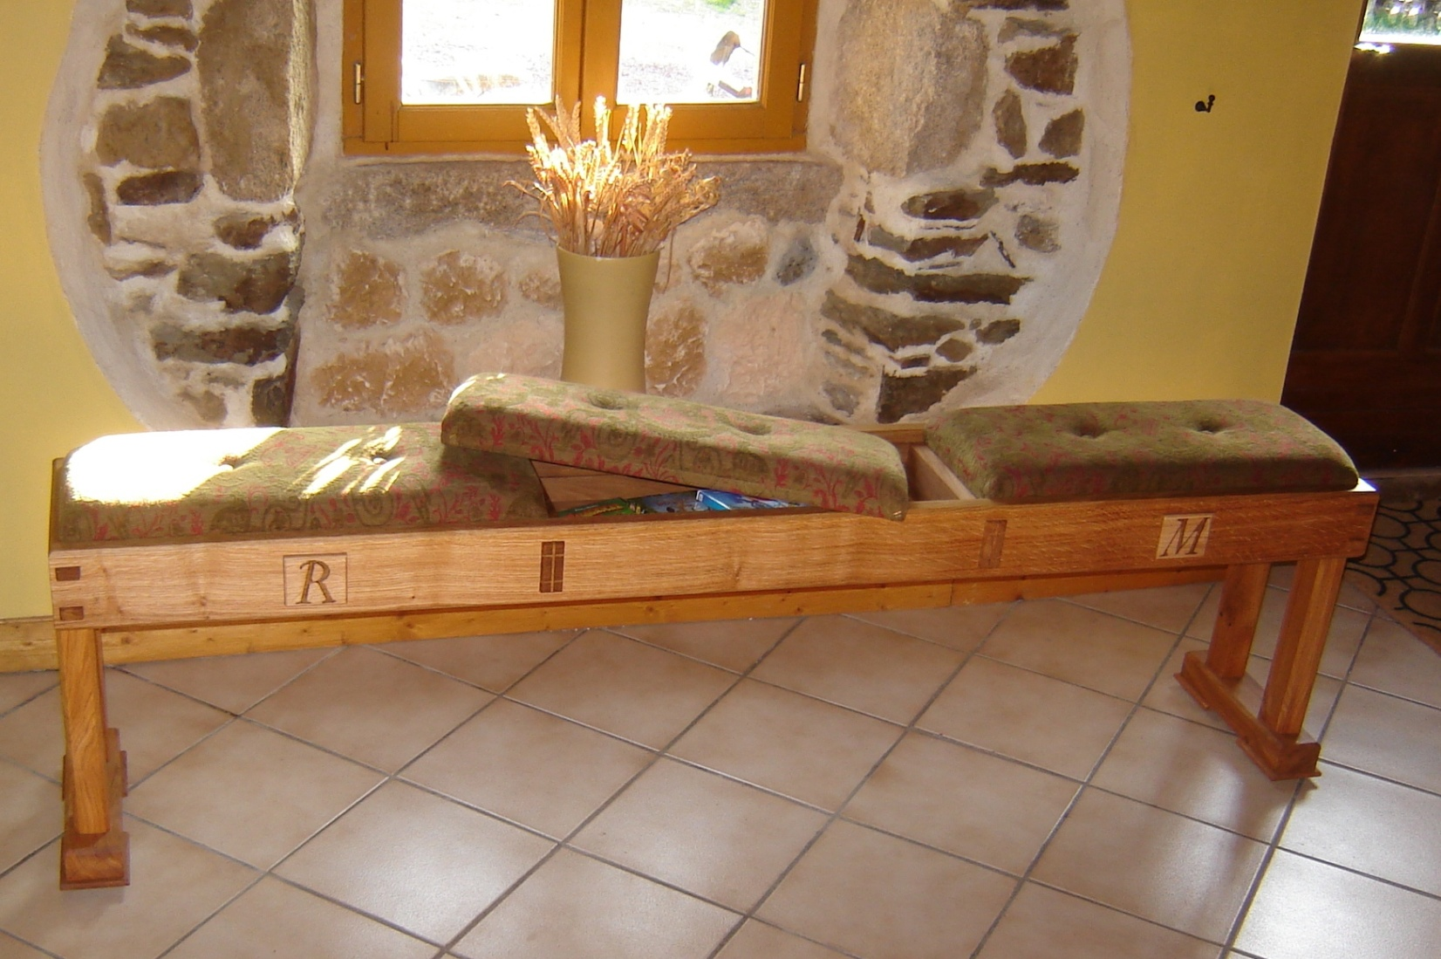
Carvings and other ‘design features’ are added
This is the result of a weeks’ work. The cushion have been upholstered, (one open to reveal the storage space beneath)

Slide 11
.... and the projects is completed and delivered.
The finished bench in its new home.

Slide 12
For More Information, Contact……
Kerry J Donovan
Office: 00 33 2 97 74 52 83
KJD Furniture Design
La Trefle
4 Le Bouix
56490 Guilliers
Morbihan
Brittany, France
http://kjdfurnituredesign.yolasite.com/

