Slide 1
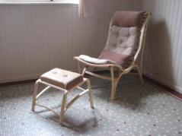
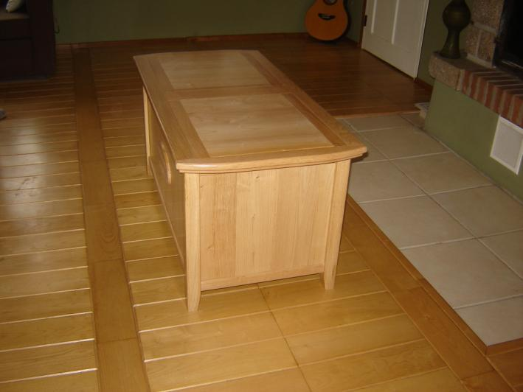
Kerry J Donovan Furniture Design
Toybox in Oak
January 2012
Notes:
Trend Consulting 2006

Slide 2
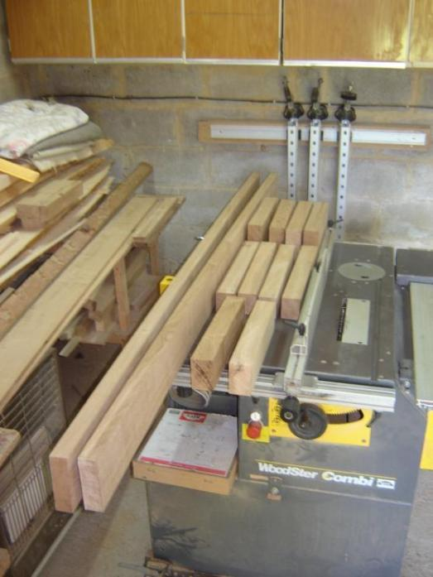
Once the project has been commissioned I select the wood
The material for this project (French Oak and Chestnut) is cut to nominal size and then planed-all-round (PAR) to the width and thickness needed....

Slide 3
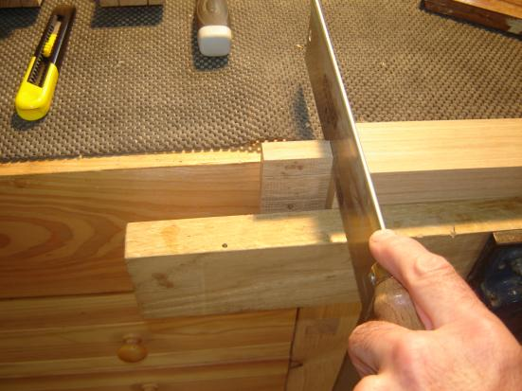
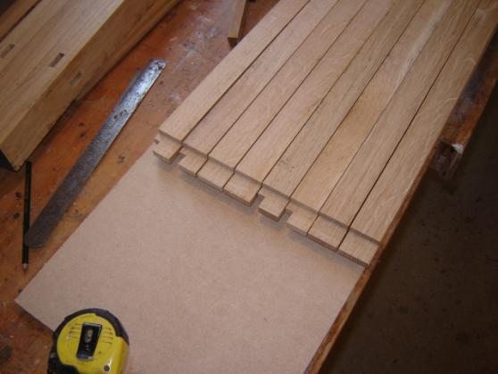
After marking them out carefully, I cut the joints
The joints are cut, mainly by hand
(yes, I’m a leftie)
These are the rails with tenon joints already cut.

Slide 4
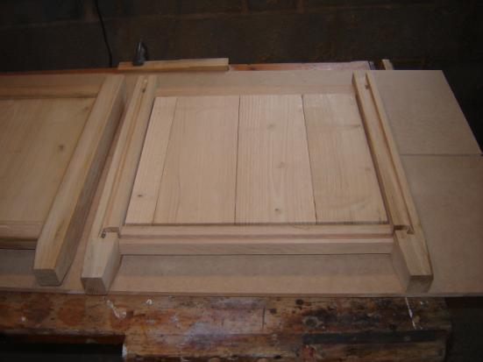
The end panels
One of the ends with it’s panel made and ready for assembly

Slide 5
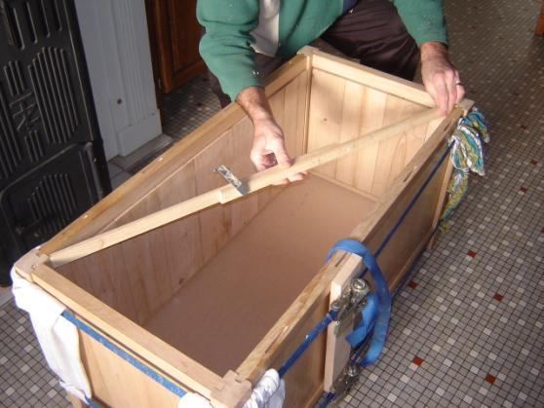
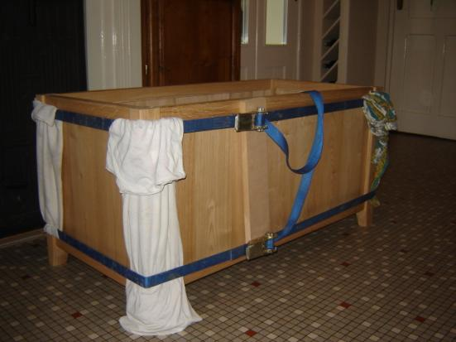
The carcase of the toy-box being glued up
I check that the carcase is square using a method that’s been around since before the time of the Pharaohs.
Webbing clamps are used to hold the cabinet together while the glue sets overnight – (the rags are to stop the edges of the legs being bruised)

Slide 6
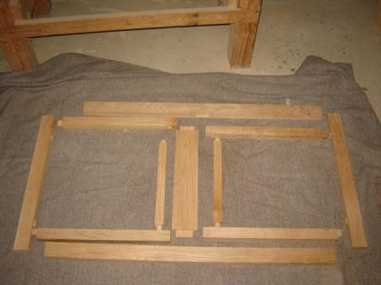
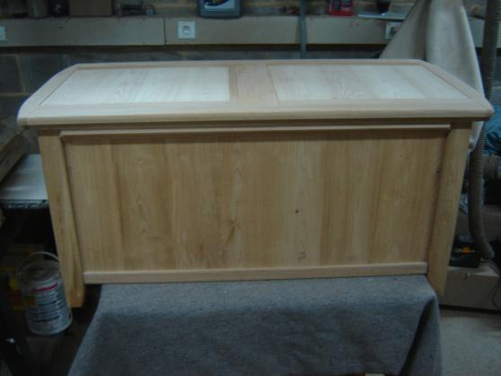
The top is made
These are all the components I need to make the top, which has two sliding panels....
..and this is the top in position. The table is now ready to be polished.

Slide 7
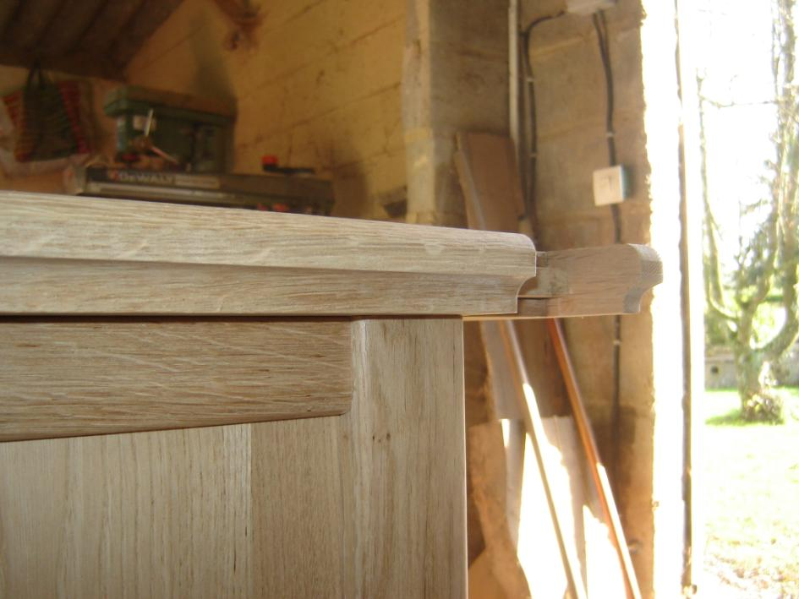
Profiling the edge of the top
As this is a toy-box, I don’t want any sharp edges, so I rounded them over (you cant do this with melamine).

Slide 8
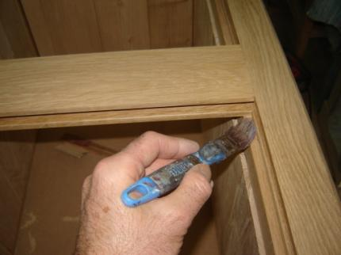
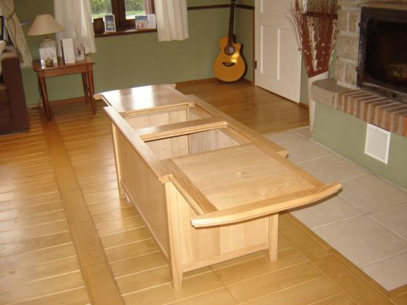
The bench is glued, clamped and the joints are ‘wedged’ and cleaned up
I lacquer and wax the running surfaces by hand to ensure the sliding panels run smoothly....
....which they do (of course).

Slide 9
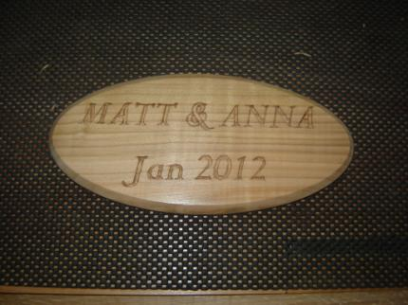
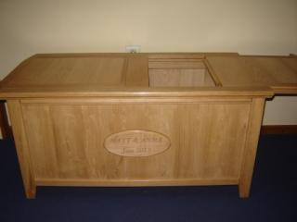
A carved plaque is added
Next, I thought is would be a nice idea to make a plaque to mark a special occasion (a new arrival).....
....and attach it to the toy-box.

Slide 10
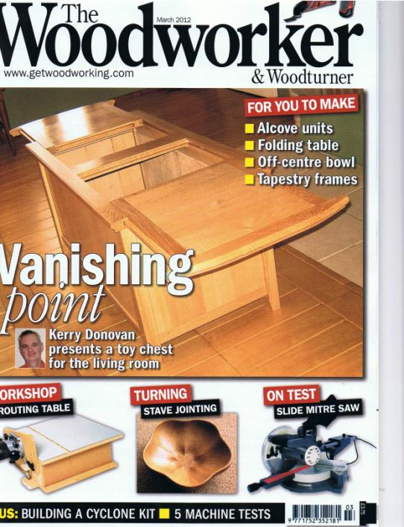
This is how it appeared on the front cover of The Woodworker - March 2012
I made sure I had the permission of the client before the article was published.

Slide 11
For More Information, Contact……
Kerry J Donovan
Office: 00 33 2 97 74 52 83
KJD Furniture Design
La Trefle
4 Le Bouix
56490 Guilliers
Morbihan
Brittany, France
http://kjdfurnituredesign.yolasite.com/

