Slide 1
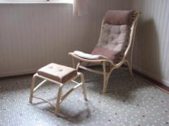
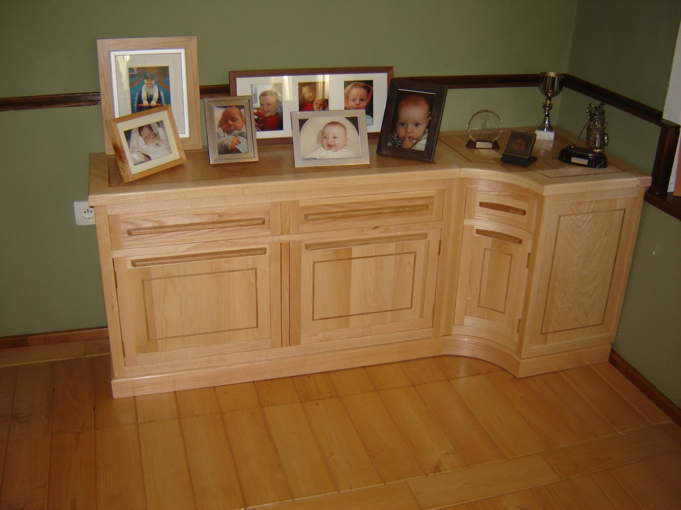
Kerry J Donovan Furniture Design
Corner Cabinet in Ash and Oak
Oct 2012
Notes:
Trend Consulting 2006

Slide 2
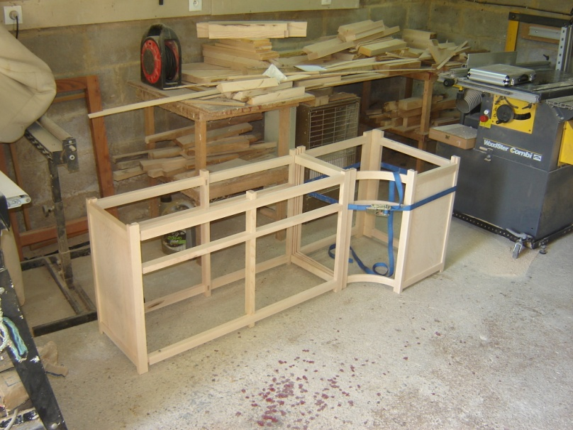
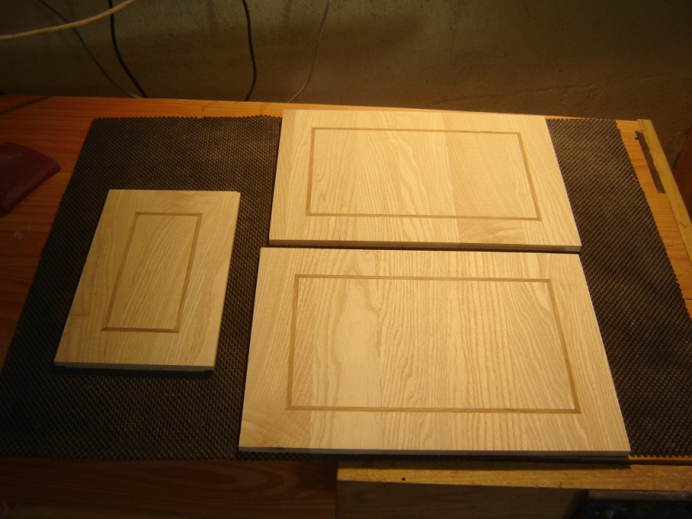
Construction and test assemblies
After the two carcases are jointed, I assemble them to check for size and ‘feel’
The door panels are made and the Oak inlay is added

Slide 3
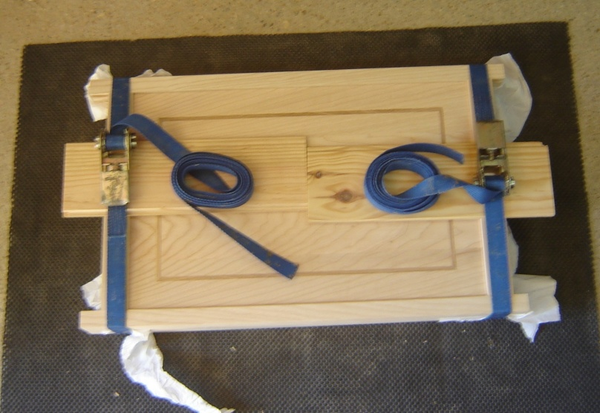
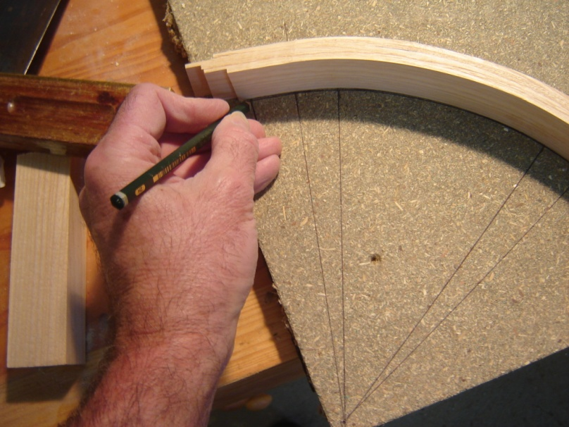
The door panels
The flat doors are glued up first – (I have to curve the small panel and make the curved door next)
A bit of old-school geometry is needed to calculate the curvature and length of the curved door and drawer components......

Slide 4
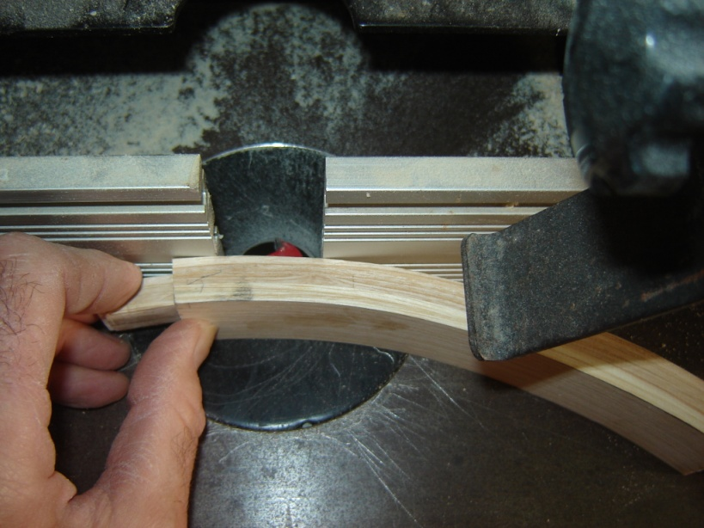
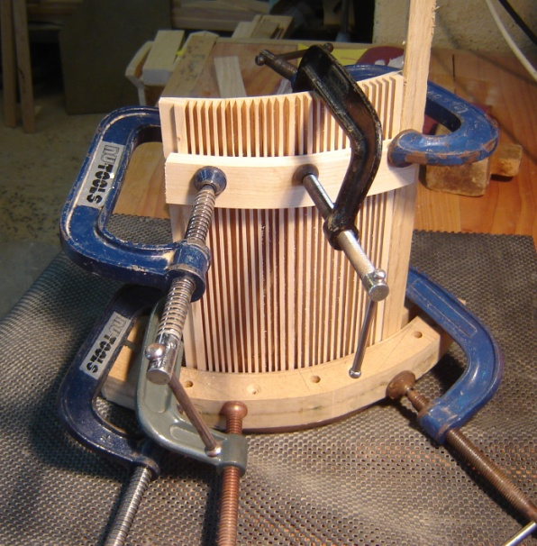
Curved components are tricky
A little detailed machining is needed.....
...before the door panel can be curved......

Slide 5
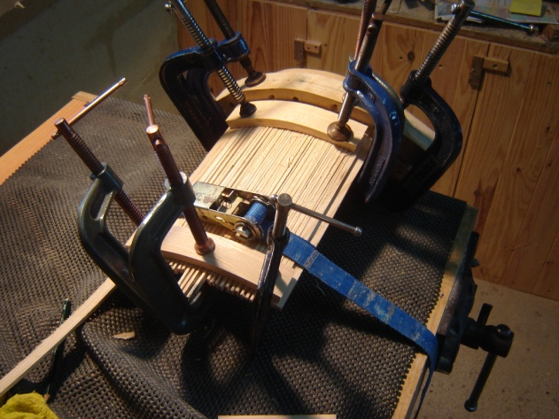
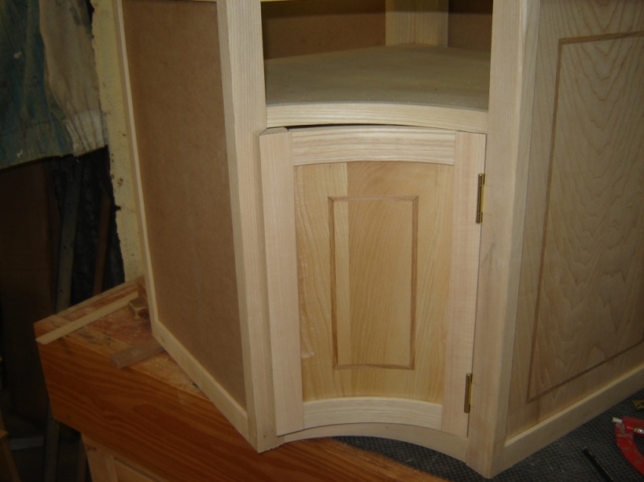
The curved door looks beautiful
....and assembled.
Now it can be fitted into the carcase.
A similar process goes towards making the curved drawer front.

Slide 6
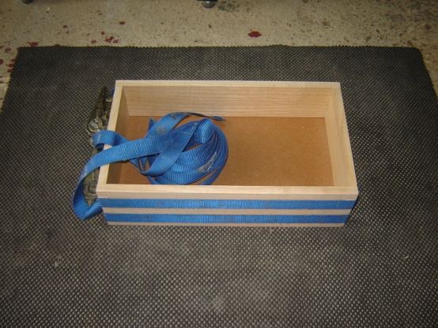
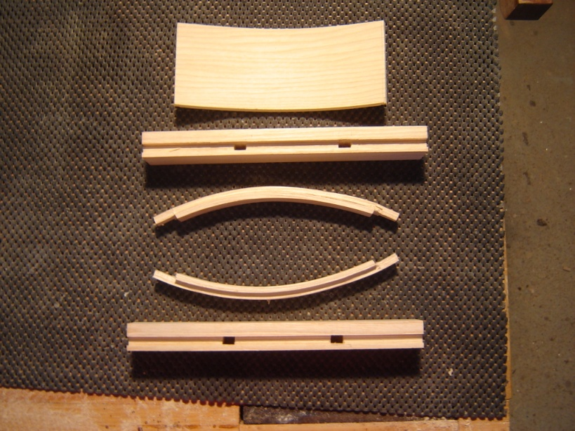
The curved drawer
First the carcase...
...and all these components go into making the curved drawer front

Slide 7
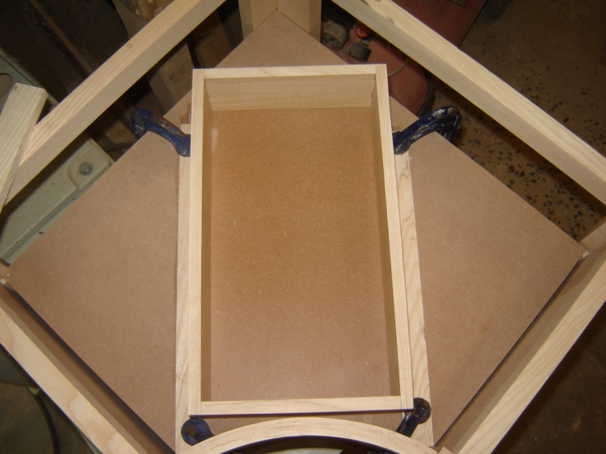
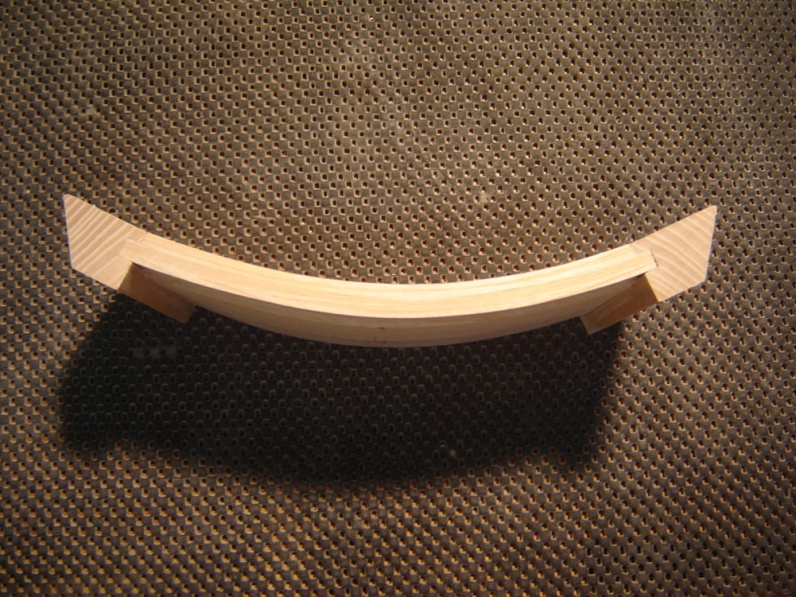
Fitting the curved drawer
A sub-frame is fitted into the cabinet...
...and the curved front is made and added to the drawer.

Slide 8
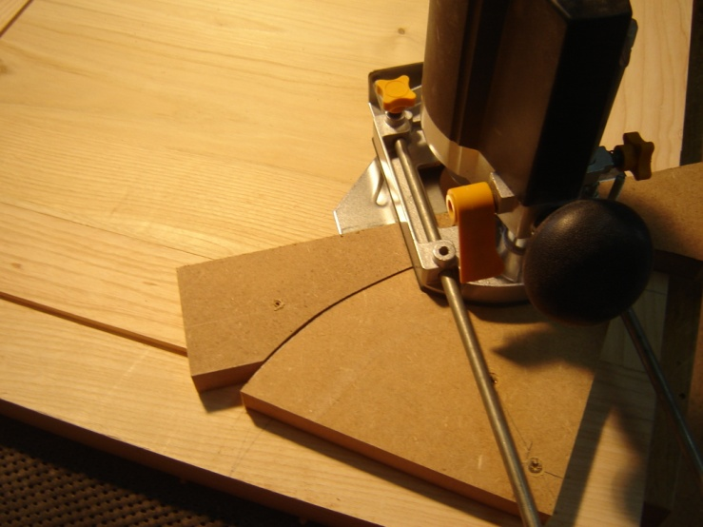
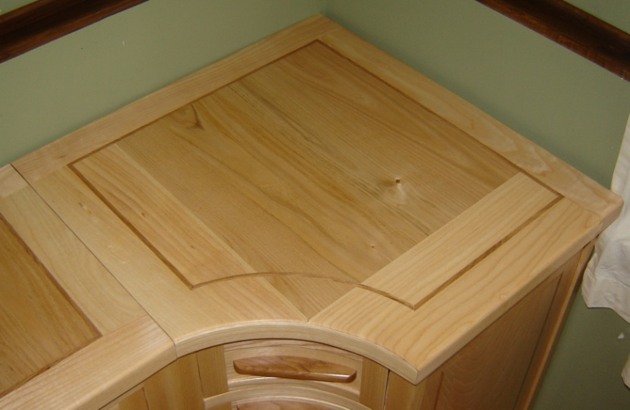
The top
I had to design a special jig to help me make the curved inlay for the top.....
....but I’m sure you agree that it was worth the effort,

Slide 9
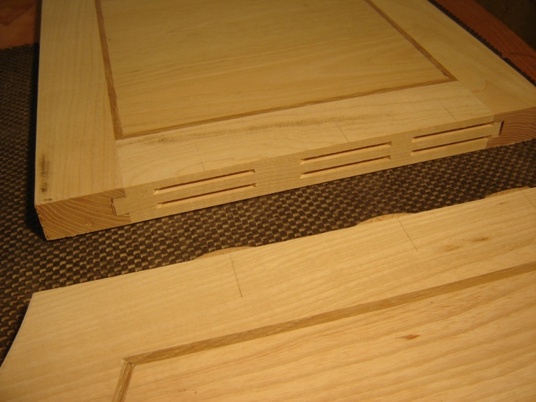
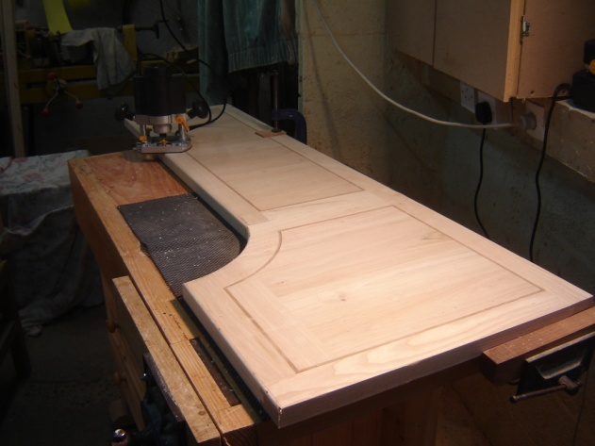
The top
The top is made in two parts...
....that fit together without the need for glue.

Slide 10
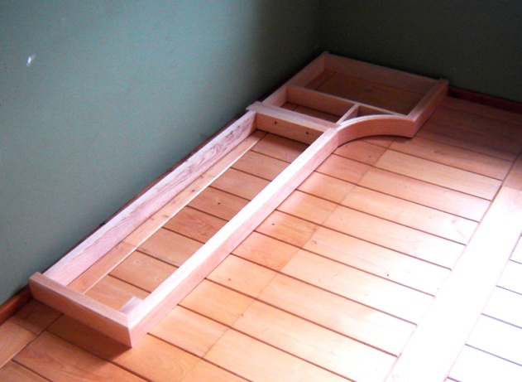
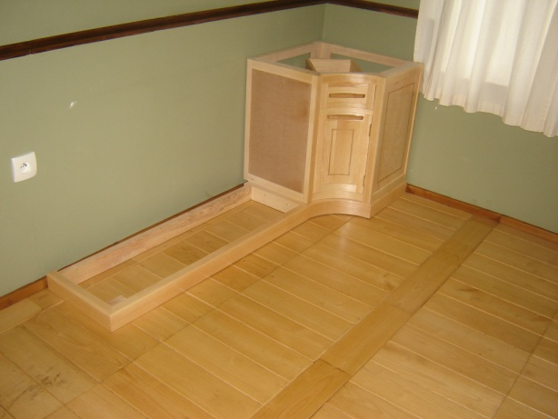
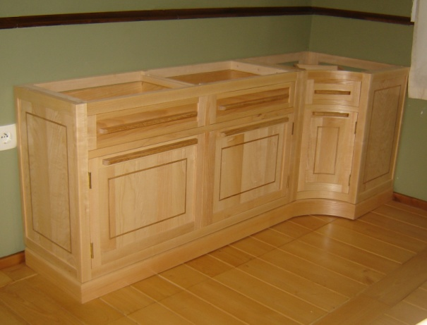
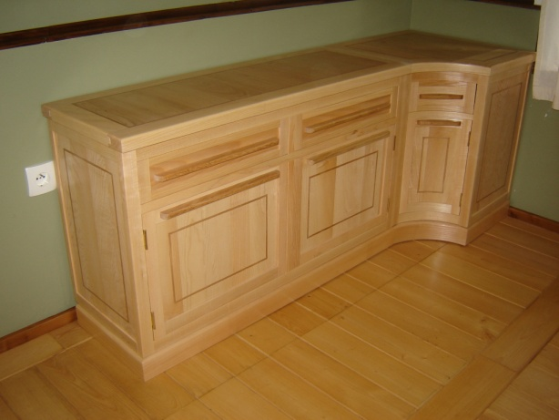
Fitting the cabinet......
Here are a few photos of how the whole assembly fits together - no screws or glue needed here.

Slide 11
For More Information, Contact……
Kerry J Donovan
Office: 00 33 2 97 74 52 83
KJD Furniture Design
La Trefle
4 Le Bouix
56490 Guilliers
Morbihan
Brittany, France
http://kjdfurnituredesign.yolasite.com/

